Slide 1
MP3 Player ISA
COA Lab Project (2016-17)
The LNMIIT, Jaipur
Rahul Dugar (15UCS105)
Vishal Sanghai (15UCS160)
Yash Jain (15UCS164)
Yash Khandelwal (15UCS165)

Slide 2
Introduction
MP3 is acronym for MPEG audio Layer-3. MPEG is the acronym for Moving Picture Experts Group.The goal of the MP3 format is to compress a CD-quality song.With MP3, a 32MB song on a CD compresses to about 3 MB.
Mp3 player was first came to existence in 1993.
Well-known MP3 players include:
Sony Walkman by Sony
iPod by Apple Computer
There are many software-based MP3 audio applications available for most computer platforms, such as Winamp, Musicmatch Jukebox and iTunes for Macintosh and Windows

Slide 3
Functions
Volume (UP, DOWN) - Add Or Subtract a value in certain Register.
Forward, Backward - Increase the index of song no.
Play and Pause - A flag register, true when song is being played false otherwise.
Rewind - Go back to particular time in song.
Shuffle - Play a random playlist.
Most played - Play the most played song.
Loop - We can keep playing a particular song in a loop.
Up and Down - Scroll through song list.
Add song - Add a particular song
Delete song - Empty the memory location .

Slide 4
Memory Model
Cell Size(Smallest addressable unit) - 8 bit (1 byte)
8 bit word in aligned memory address way.
Linear address space with common address space for both instruction and data from 0 to 2⁸ bytes.
All memory requests can be serialized, so that each one is completed before the next is issued.
Notes:
Why aligned?
Ability to read words at arbitrary addresses requires extra logic on the chip.
We don’t have to be backward compatible.
Sometimes microinstructions are reordered.

Slide 5
Register
General purpose CPU registers to keep the track of the duration of song.
register to point the current song.
Flag register or PP Play, Pause, Shuffle, Loop
Program Counter
Volume Register
Register to point to the playlist which is being played.

Slide 6
Instruction Format
0 Address Instruction
Pause (A flag register)
Shuffle (Generate a random no.)
Most Played
Delete Current Song
1 Address Instruction
Volume (UP, DOWN)
Forward, Backward
Play
Loop.
Play current song.
2 Address Instruction
1.Add Song
2.Rewind()
Notes:
Loop - One address instruction (Pass to repeat this song or every song).
Add song - Two address instruction (which song to add and where to add(which playlist)).

Slide 7
Instruction Design
We will use Zero, One and Two address instructions(as shown in previous slide).
Zero address instructions will use all 8-bits as its opcode.
One address instructions will use 3-bits for address and remaining 5-bits for opcode.
Two address instructions will use 6(3-3)-bits for address and remaining 2-bits for opcode.

Slide 8
Instruction Type
Monadic Operations (one operand and one return result).
Dyadic Operations (combine two operands to generate a result).
Arithmetic Instructions.
Comparison and Conditional Instructions.
Logical Instructions.
Loop Control instructions (to count the played duration).
Notes:
Monadic - Volume (UP, DOWN), Forward, Backward, Play, Loop, Up and Down, Playlist
Dyadic - Add song, Rewind

Slide 9
Data Types
Numeric
Integer - 16 bit signed (leftmost bit denote sign)
Non-Numeric
ASCII Character Code(7 bit)
Boolean (2 byte - bit map)
Pointer - Machine Address ( 8 bit)
Use Case:
Song_Duration(in minutes) - integer
Song_Status - Boolean
Song_Name - Character
Total_No_Songs - integer
Notes:
Max integer required is length of song is seconds, which comes around 5 minutes = 300 seconds.
Individual bits in a bytes do not have specific address and hence are hard to access.
Each bit stores 0/1 in 1 bit. 16 bit map can store status of songs of 16 songs at once.

Slide 10
Addressing Mode
Immediate - To update flag values.
Register - Load current song details to add to playlist.
Direct - Load song in memory from storage device.
Register Indirect - Play song location of which is in another register.
Base Indexed Addressing Mode - Will set Offset as a starting point of any playlist and then we can increase it by any index in accord with user.

Slide 11
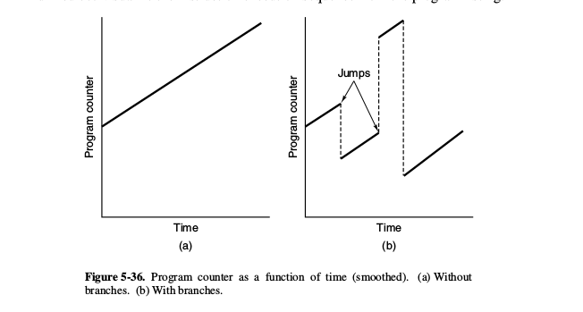
Flow Of Control
To play the list in an orderly Fashion(fig a) without any procedure or Subroutine calls.
When pause, shuffle,etc is Issued then it is difficult to keep the track (branches are made fig(b)).
Notes:
We will be using trap and interrupt handlers for any inconve
nience of errors or multiple calls of functions.
Output handler which shows on the screen how output is coming.

Slide 12
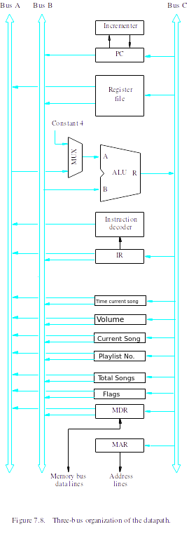
dATA pATH
(MULTI-BUS)
Notes:
We will be using trap and interrupt handlers for any inconve
nience of errors or multiple calls of functions.
Output handler which shows on the screen how output is coming.

Slide 13
ALU DESIGN
AND
8:1 MUX
000
CMP
001
ADD
010
SUB
011
MOD
100
1
101
8
110
S2
S0
S1
Notes:
We will be using trap and interrupt handlers for any inconve
nience of errors or multiple calls of functions.
Output handler which shows on the screen how output is coming.

Slide 14
Control Unit (Microprogrammed Control)
Fetch Cycle :
PC_{OUT}, R=C, MAR_{IN}, READ, IncPC
WMFC
MDR_{OUTC}, R=C, IR_{IN}
Notes:
We will be using trap and interrupt handlers for any inconve
nience of errors or multiple calls of functions.
Output handler which shows on the screen how output is coming.

Slide 15
Micro Routines
Pause :
Set PP flag,END
DCS :
R7out-B, Select 1, SUB-R07in,
R05out-B, Select 1, SUB-R05in, END
VOLU :
R4out-B, Select 1, ADD-R4in,END
VOLL :
R4out-B, Select 1, SUB-R4in,END
PLYD(immediate) :
Immediate value_R05, MARin, Read
WMFC, MDRin, R00in, R00out-B, Select 1, ADD-R00in, MDRin
R05out, MARin, write, END
Notes:
We will be using trap and interrupt handlers for any inconve
nience of errors or multiple calls of functions.
Output handler which shows on the screen how output is coming.

Slide 16
Micro Routines
PLYR (Play current Song):
R05out, MARin, Read
WMFC, MDRin, R00in, Select 1, ADD-R00out, MDRin
R05out-B, MARin, write, END
LPD
Immediate value_R05, MARin, Read, Set Loop flag
WMFC
MDRin, R00in
R00out-A, R01out-B, Select A, ADD-R00in, MDRin
R05out, MARin, write, END
REWD :
Immediate value_R03,END
Notes:
We will be using trap and interrupt handlers for any inconve
nience of errors or multiple calls of functions.
Output handler which shows on the screen how output is coming.

Slide 17
Micro Routines
ADSD :
R07out-A,R00out-B,select A, ADD, R07in
Select 8, R07out-A, SUB,R00in,CMP
if(R00=0 Z=1,R00<0 N=1,R00>0 No Flag),END
SFL :
R07out-A,R05out-B, Select A, ADD, R00in
R00out-A,R07out-B,Select A, MOD,R05in,END
MPS :
R00 out-A, MARin,Read
WMFC, MDRout-B,R=B,R01in,LOOP Until it becomes equal to R07
Now we will compare different value of count by Storing in R01,R02 and using the CMP function and store the maximum among them in R00.
Notes:
We will be using trap and interrupt handlers for any inconve
nience of errors or multiple calls of functions.
Output handler which shows on the screen how output is coming.

Slide 18
Control Word
We will be using Vertical Positioning.
F0: (8 bits) Address of Next micro-instruction.
F1: (4 bits) 0000-Offset,0001-PCout,0010-MDR(out),0011-Zout,1000 R00in,....1111-R07in
F2: (4 bits) 0001-PCin,0010-IRin,0011-IRout,1000-R00out…..1111-R07out.

Slide 19
Control word
F3: (2 Bits) 01-MARin,10-MDRin,11-Yin
F4: (3 Bits) 000-ADD,001-SUB,010-CMP,011-AND,100-OR
F5: (2 bits) 00-No action,01-Read,10-Write.
F6: (2 Bits) 00-Select Y,10-Select 8,11-Select 1
F7: (1 Bit) 0-No action, 1-WMFC
F8: (1 Bit) 0-Continue, 1-End

Slide 20
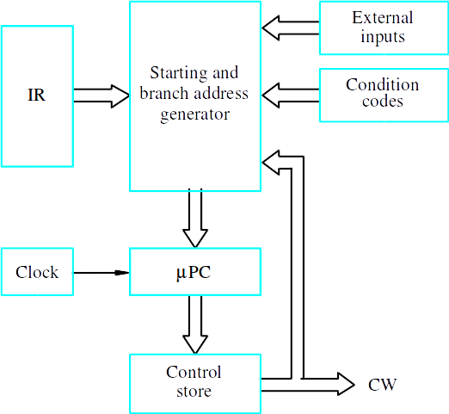
Control Unit

Slide 21
THANK YOU

